Slide 1
Doctor Appointment No-show Predictions
Antonio Alonso

Slide 2
Data Dictionary
PatientId: Unique ID for each patient
AppointmentID: Unique ID for each appointment (used as the index)
Gender: Gender of the patient (M or F)
ScheduledDay: Day when the appointment was originally scheduled
AppointmentDay: Day for which the appointment was scheduled
Age: Age of the patient
Neighbourhood: Patient’s Neighbourhood
Scholarship: Whether or not the patient has a government scholarship/grant
Hipertension: Whether or not the patient suffers from hypertension
Diabetes: Whether or not the patient suffers from diabetes
Alcoholism: Whether or not the patient suffers from alcoholism
Handcap: Whether or not the patient is handicapped
SMS_received: Whether or not the patient was reminded by SMS prior to the appointment
No-show: Whether or not the patient missed the appointment. This will be the target variable to be predicted.

Slide 3
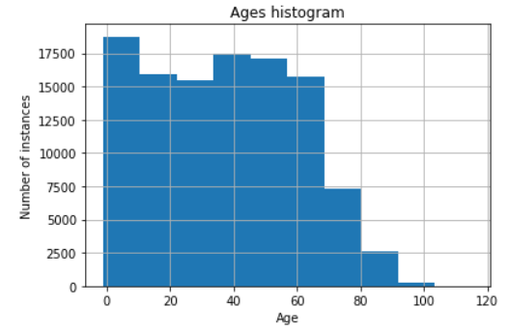
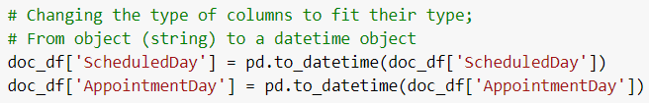
Cleaning the Data
Luckily, for this dataset there were no missing values. Cleaning the data consisted of finding outliers and nonsensical values.
For the ‘Age’ column, there was a patient with age -1, this row was dropped as it did not make sense. The highest value in this column was 115, which seems like a possible limit for age, therefore this value remained.
For the rest of the cleaning, I converted the ScheduledDay and the AppointmentDay into datetime objects from strings, and changed No-show and Gender to numerical values. Furthermore, some of the columns were renamed to more conventional names.

Slide 4
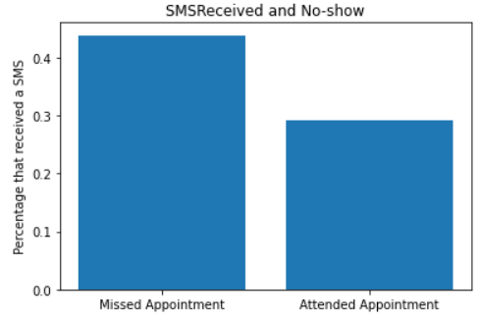
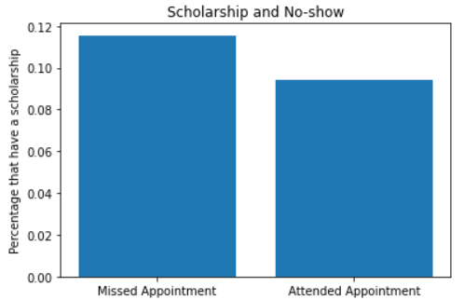
Exploring the Data
When exploring the data, I was trying to find any relationship between our target variable (No-show) and any of the features. The most surprising finding was that those that did miss the appointment were reminded by SMS at a larger rate than those that did attend the appointment. This makes me believe that those that are likely to miss the appointment were more likely to be reminded an SMS.
Another surprising finding was that those who missed an appointment were more likely to have a scholarship

Slide 5
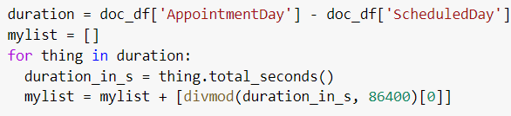
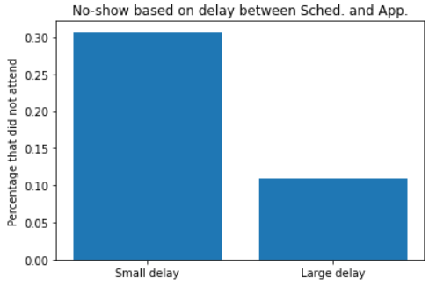
Feature Engineering
The fun part! In order to be able to use the ScheduledDay and AppointmentDay columns, I needed to convert them into a usable data type (not datetime), so I decided to use the day of the week (Mon-Sat) as the feature. Other aspects like month or week of the year were not used because the data did not span years or even the entire year.
Furthermore, the difference between the scheduled day and the appointment day was added as a feature because I figured that if more time had passed since the scheduling, maybe people were more likely to miss the appointment.
unexpectedly, it seems like with a large delay, there is a smaller chance to miss the appointment.

Slide 6
Machine Learning
Set up the data - Columns with discrete values were turned into numerical data columns - One Hot Encoding method was utilized - Dropped Neighbourhood column because it was taking too much . time to train models, less feature columns speeds it up - Split the data into a training and a testing data set (80:20 split) - The target vector was the NoShow column - Fit and transform data for the KNN model (not random forest) - Used PCA transformed data because it was giving better results.

Slide 7
Models
Three different types of models were used, K-Nearest-Neighbors for classification, XGBClassifier, and Random Forest for classification. In all cases for the models, the number of neighbors/estimators was optimized by testing many different values in a range and finding what value gives the highest accuracy. Two of the models, XGB and random forests, had overall similar accuracies, but the KNN model had a higher accuracy, capping out at around 80%.

Slide 8
Recommendations
Based on the importances of some features, here are some recommendations on how to minimize appointment no shows:
Since a small delay between ScheduledDay and AppointmentDay seems to increase the probability of missing the appointment, it might be a good idea to remind these patients by SMS.
It is important to notice that just because those who missed the appointment were more likely to receive an SMS, doesn’t mean that the SMS is the reason for it.
Patients to missed their appointments had, on average, a lower age, so it might be fruitful to remind younger patients more often.

